Slide 1
Science to Action: Thoughts on Convincing a Skeptical Public
William H. Press University of Texas at Austin 2015 William D. Carey Lecture April 30, 2015

Slide 2

Actual full page ad in USA Today and The Wall Street Journal February, 2015)

Slide 3

This is the only way that it could be less effective, in my opinion!

Slide 4
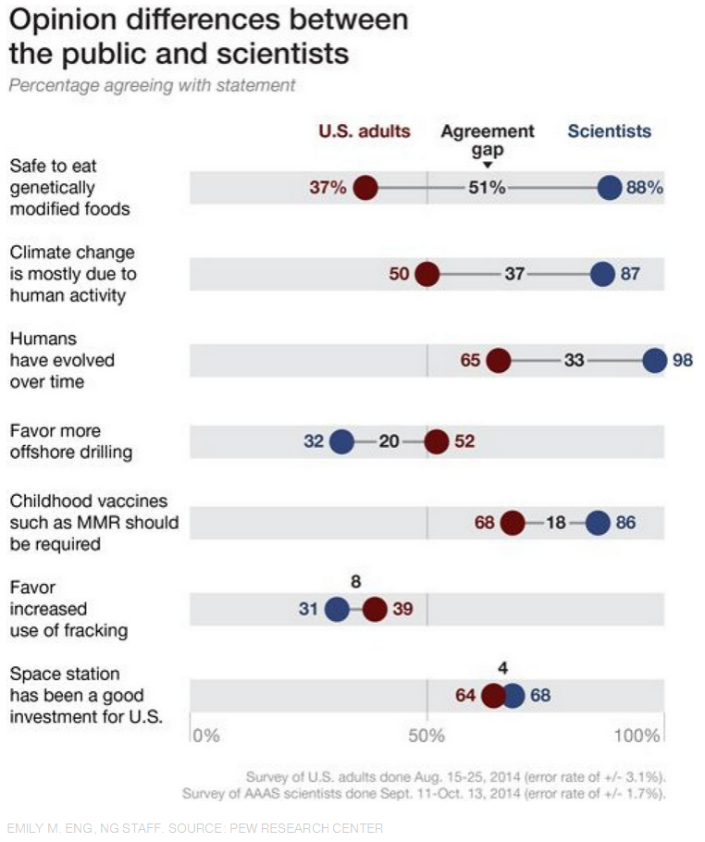
National Geographic (January, 2015) reporting on Pew poll (2014)
The questions are a mixture of being about scientific fact, and about the opinions of scientists—two quite different things!

Slide 5
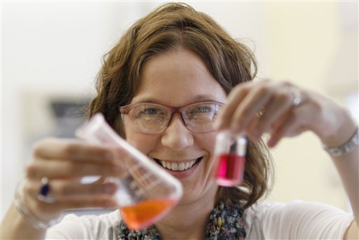


Storyline No. 1
Scientists who are motivated by a sense of pure discovery observe, measure, and characterize a new phenomenon.
Other scientists and engineers, motivated by a desire to create applications, develop technologies and inventions that utilize the new phenomenon.
The results are new products, jobs, and industries.

Slide 6
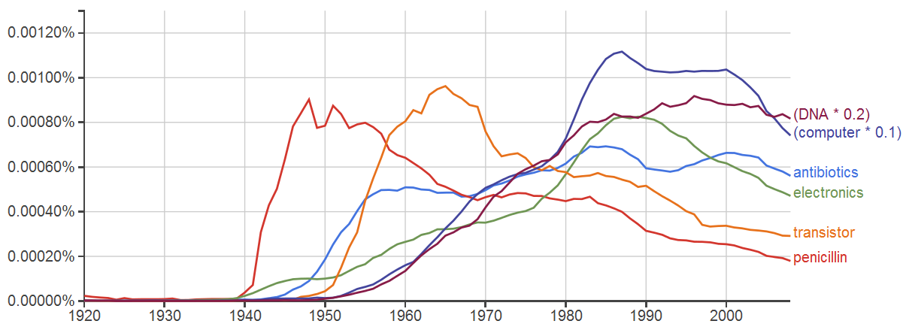

What do successes look like? The rise of new industries.
Disclaimer: N-grams are not always accurate indicators of social trends. However, they are fun.

Slide 7
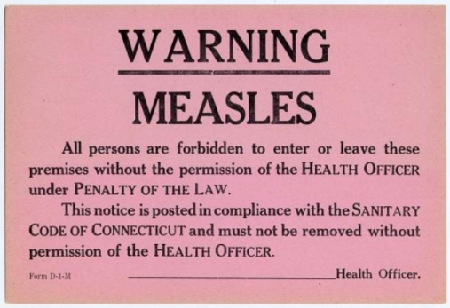


Storyline No. 2
Scientists familiar with the data recognize a danger or hazard to the public.
They convince the public that action is needed, often despite opposition from economic interests or people who disagree with the evidence.
The result is appropriate action by government and favorable outcomes for the public.

Slide 8
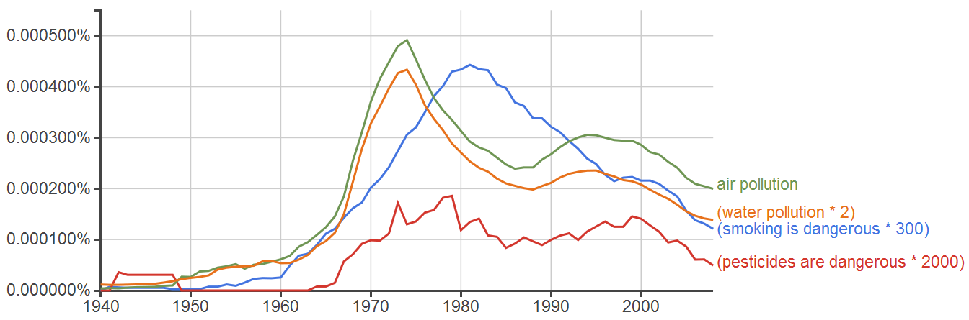
What do successes look like for Storyline No. 2? Discussion rises, action is taken, issue loses urgency

Slide 9
The two storylines are quite different.
No. 1: Scientists enabling research discovery, invention, and development
“what can be”
No 2: Scientists educating the public and advocating action and change
“what should be”
These are both important roles for scientists.
But they are different and distinct
and require different kinds of interaction with the public

Slide 10
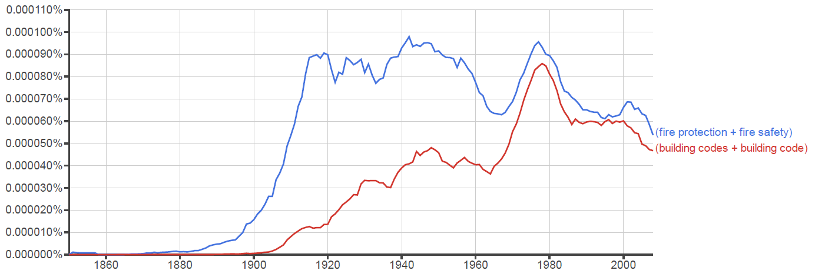
Storyline No. 2 successes are not all post-WWII phenomena
Triangle Shirtwaist fire (1911)
San Francisco earthquake (1906)
Iroquois Theater fire (1903)
Chicago fire (1871)

Slide 11
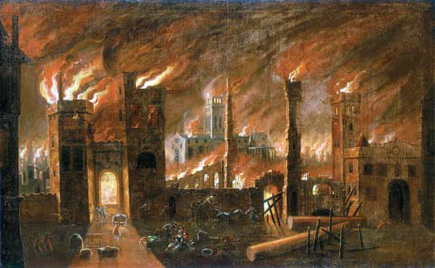
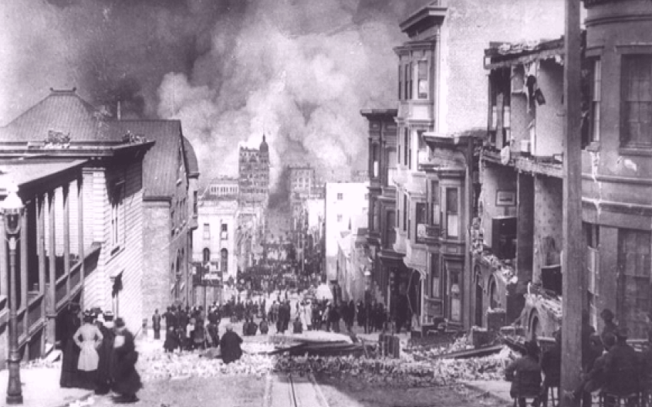


Fire protection as a case study
The hazard was one familiar to the public.
There were catalyzing events.
There were effective and affordable mitigating technologies.
1890: Grinnell’s glass disk sprinkler head
Economic interests were not exclusively on one side
1894: Underwriters Laboratories

Slide 12
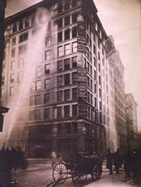

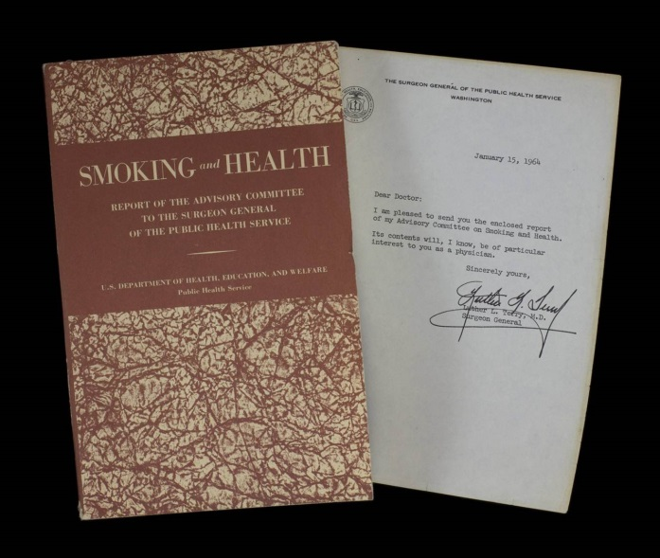
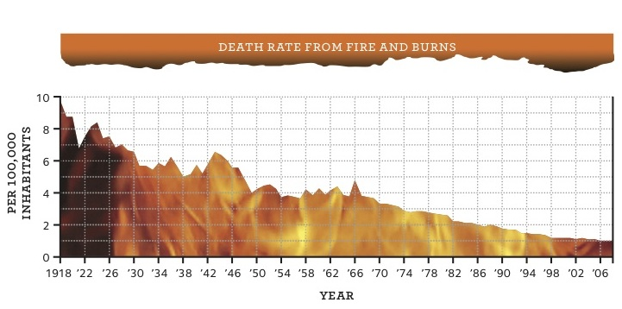

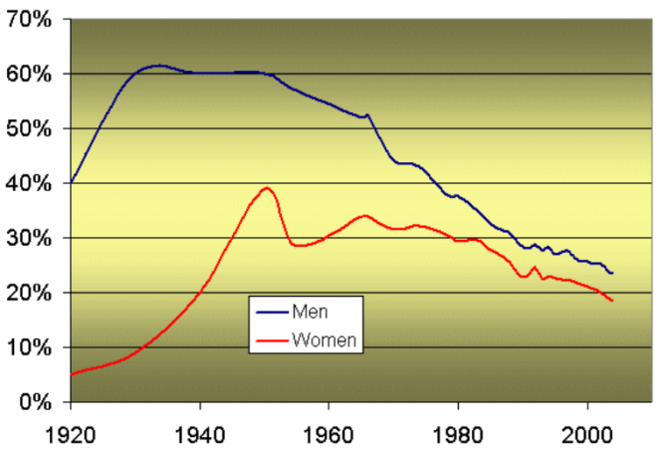
We might hope for progress without “catalyzing events”, but history indicates otherwise
1911
1962
1964

Slide 13
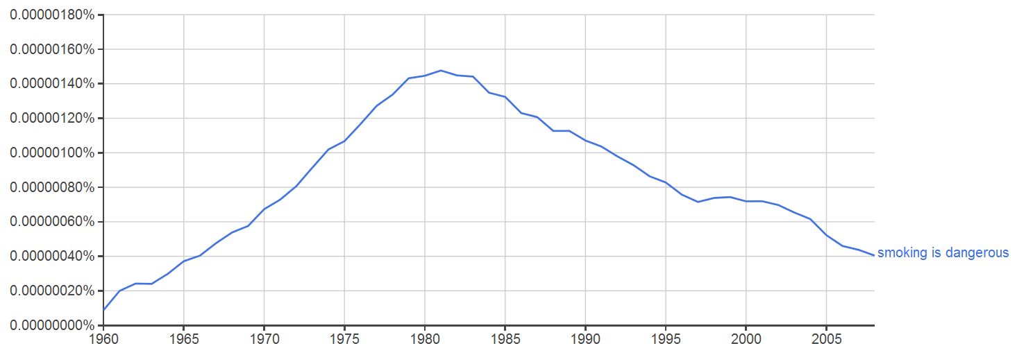

Case study: Smoking
Is the hazard familiar to the public? ✓
Have there been catalyzing events? ✓
Are there effective and affordable mitigating technologies? ✓
Are economic interests not exclusively on one side? ?→✓

Slide 14
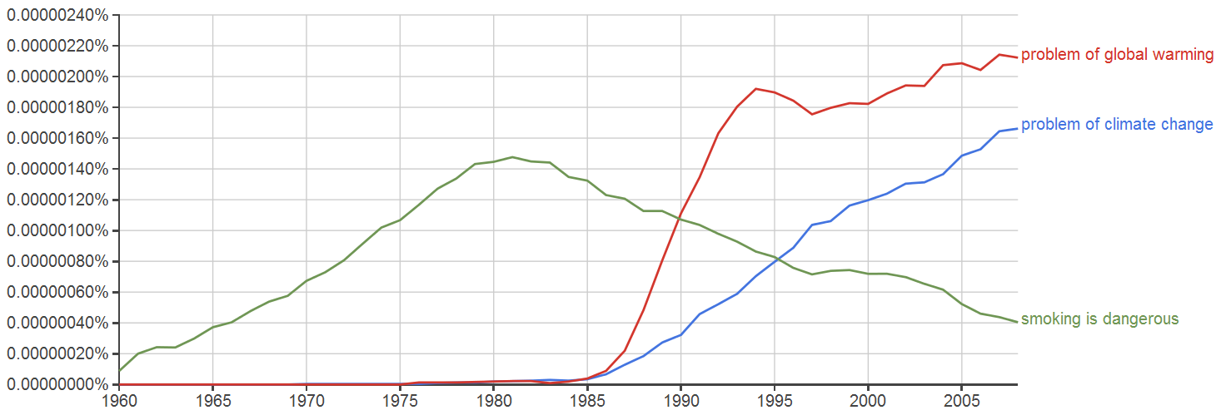
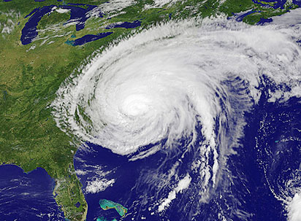
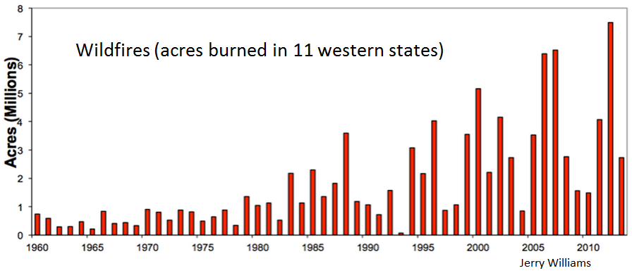
Case study: Climate
Is the hazard familiar to the public? ?→✓
Have there been catalyzing events? ?→✓
Are there effective and affordable mitigating technologies? ? …or… ✓
Are economic interests exclusively on one side? ?→✓
Sandy, 2012

Slide 15


Ambiguities arise when Storyline No. 2 masquerades as Storyline No. 1
A hazard
exists,
is mitigatable by technology,
so it should be mitigated.
A new technology
exists,
can make better lives,
so it should be widely adopted.
In substance, these are both Storyline No. 2!
the operative word is “should”

Slide 16
How successful are efforts to influence public opinion on these two variants?
“Mitigating hazards”
Fire safety
Food safety
Building codes
Vaccination
Tobacco
Pesticides
Air/Water pollution
Climate change
Antibiotics overuse
Cybersecurity
“Making better lives”
“Chemicals”
Nuclear power
GMOs
Targeted advertising
Sharing economy (Uber, AirBnB)
Color code:
Success,
Ambiguous,
or Failure
at convincing the public.

Slide 17
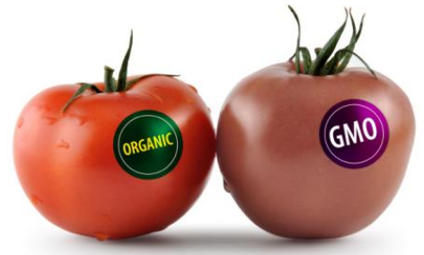
Two views on GMO labeling expressed by scientists (overheard)
“GMO labeling is scientifically misleading. It creates externalities with identifiable costs, such as higher food prices, and poorer nutrition in the developing world. It sets a precedent for anti-scientific public policy. Governments should discourage GMO labeling.”
“GMO labeling is a matter of consumer preference. As long as a GMO label is not designed to be intentionally confused with a safety label, science and scientists have only a limited special role in this debate.”
The point: This is a debate about values, not about science.

Slide 18
Perils of using the word “should”
A matter of judgment, not of scientific fact
Whose judgment?
Are “people like me” represented in the process?
Do scientists have, or claim, a special role in judging?
At what cost and to whom?
Disruptive to established economic interests?
Implying a redistribution of wealth?
Implying a perturbation of political influence?
By whose moral compass?
My values are different from yours.
My priorities are different from yours.
My beliefs are different from yours.
My tolerance for change is different from yours.

Slide 19
1. Science is a fact-discovering enterprise. 2. Science is a rationalist approach to life.
Quantification
Experimental validation
Repeatability
Underlying natural laws
Statistical inference
Processes
open publication
peer review
advancement by merit
Translational path to applications
Decisions based on data
Weighing pros and cons
Skepticism about the use of
untestable “facts”
assertions based on authority only
Some version of a utilitarian metric
Some belief in the efficacy of action
the future can be different and better
This is a methodology.
This is a value system.

Slide 20
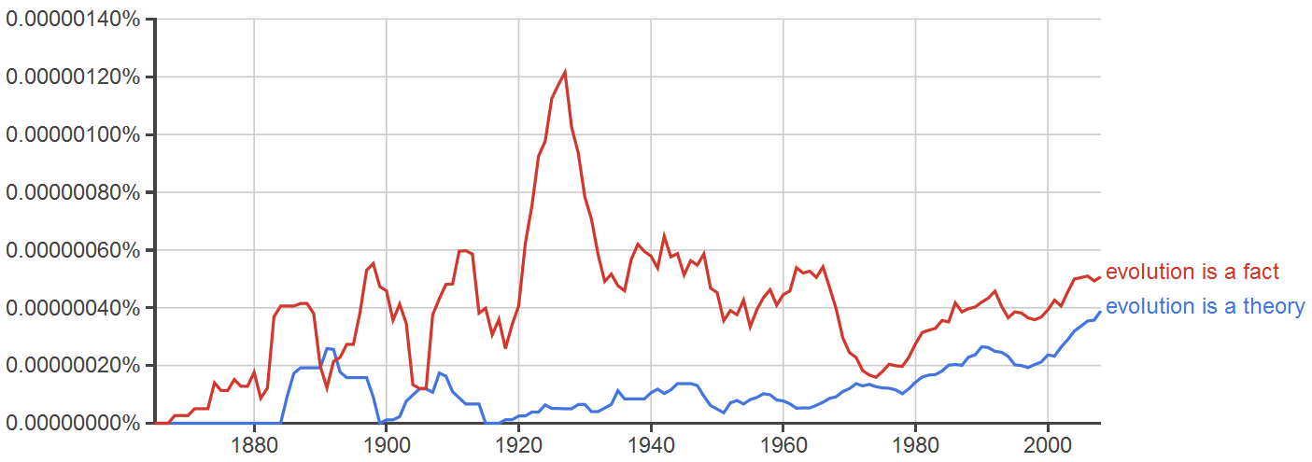
There are competing value systems and they are unlikely to disappear any time soon

Slide 21
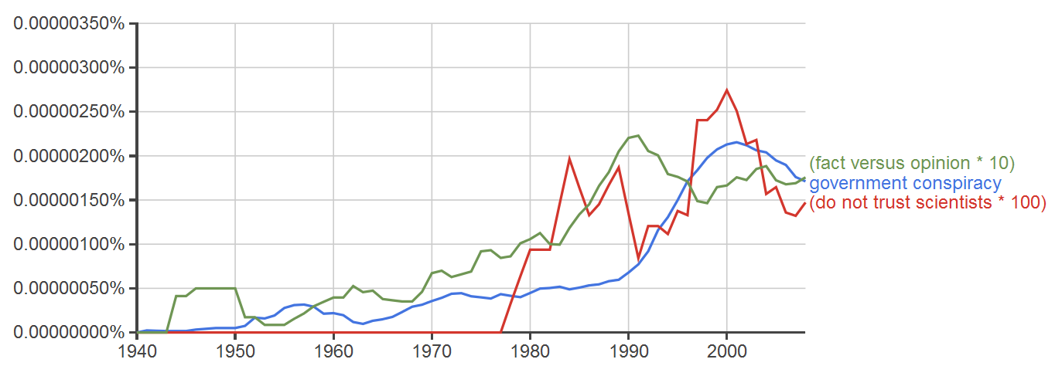
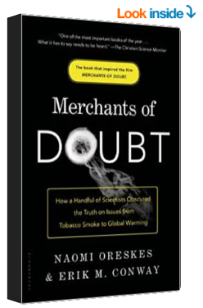
In recent decades, distrust of science has increased in a way that does not appear merely cyclical.
A significant part of this is distrust appears to be financed by contrary business interests, a marketing strategy first perfected by the tobacco industry. Unfortunately, this is the new reality for current and future science-based issues.

Slide 22
What should* the scientific community do? I.
More clearly separate fact-based conclusions from value-based judgments, even when both are valuable
Journals should publish more opinion labeled as such
And be more rigid in excluding “should” (and its equivalents) from refereed publications
Be more active in communicating the merits of a rationalist approach to decision-making
By our own example in the public space
In education, e.g., “How would a scientist approach this policy decision?”
Be careful and selective in invoking science as a privileged platform
Less “This data shows that we need to…”
More “Speaking for myself…”
But not shy about “It is an accepted scientific fact that…”
* using the word carefully

Slide 23
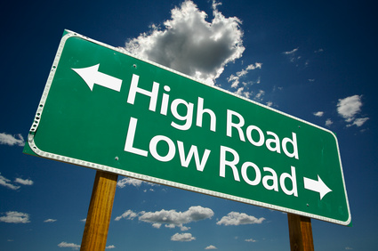
What should the scientific community do? II.
Be less dismissive of unscientific (as we might see them) value systems.
First rule of marketing: “Knocking the competition destroys credibility—yours.”
Be more assertive in reacting to threats to the integrity of science
More criticism of poor quality science, even that which supports our values (the “irresistible” finding)
More meaningful disclosure of funding sources—ultimate source, not opaque fronts—as condition of publishing
More calling out of meretricious balance (“there are two sides to every issue”) when it is poor journalism
More calling out “merchant of doubt” campaigns and their practitioners (tobacco, climate, …)

Slide 24

In the long run, convincing the public is a long, two-step process.
Step 1: Communicate the value of a rationalist approach to decision-making
Step 2: Communicate well-established scientific results
We need to be better at both kinds of communication.

